Slide 1
Trousdale Racer
Charlie Feuerborn
Michelle Wong
Nebula (Xinyin) Liu
Sean Vovan
Can you survive the busy bustle of USC’s main throughway?

Slide 2
Phaser

Slide 3
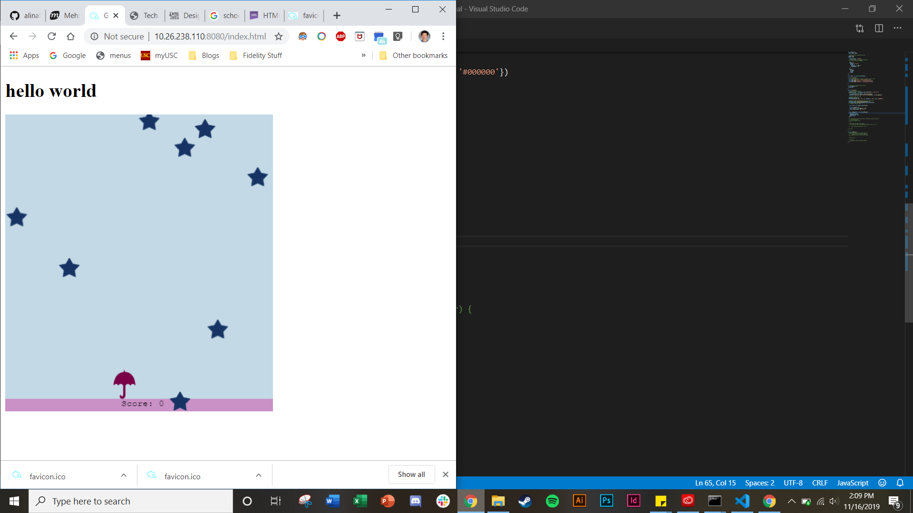
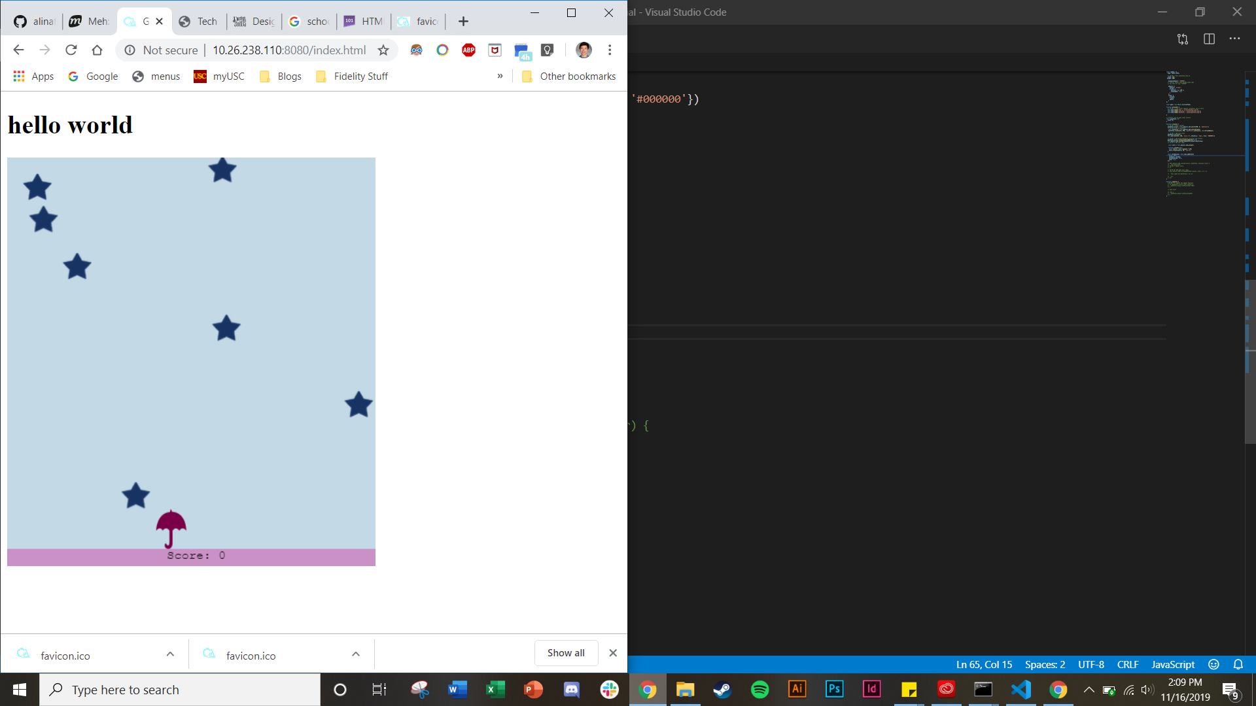
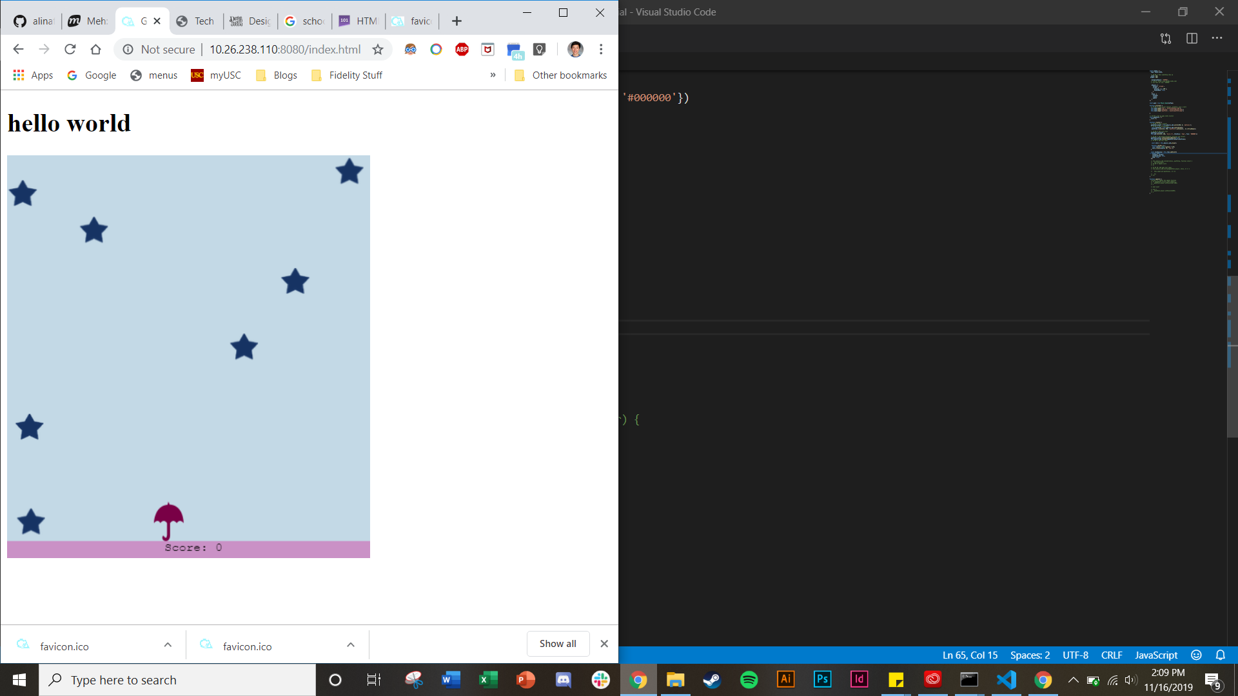
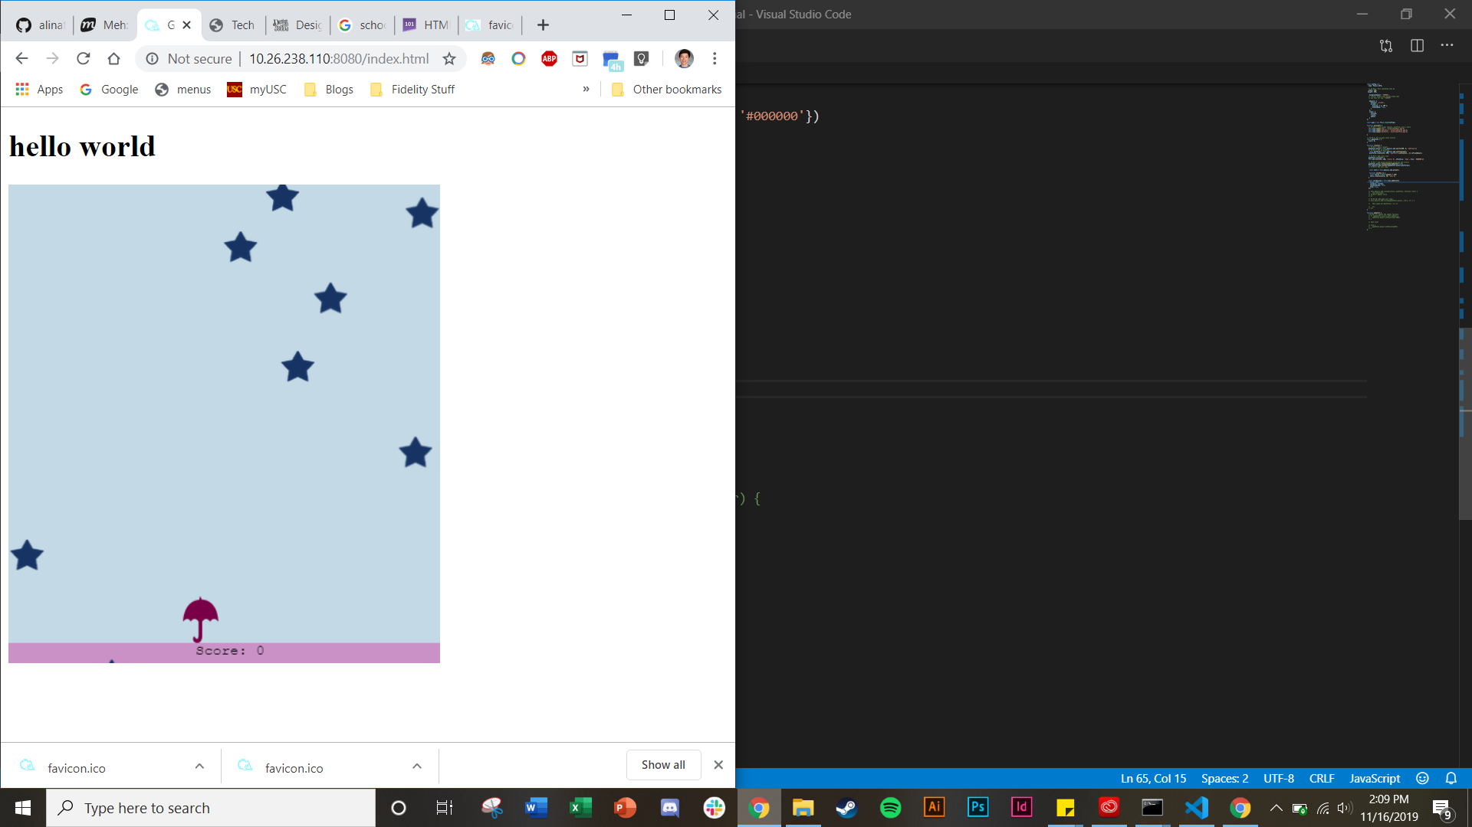
Alina’s Phaser tutorial

Slide 4
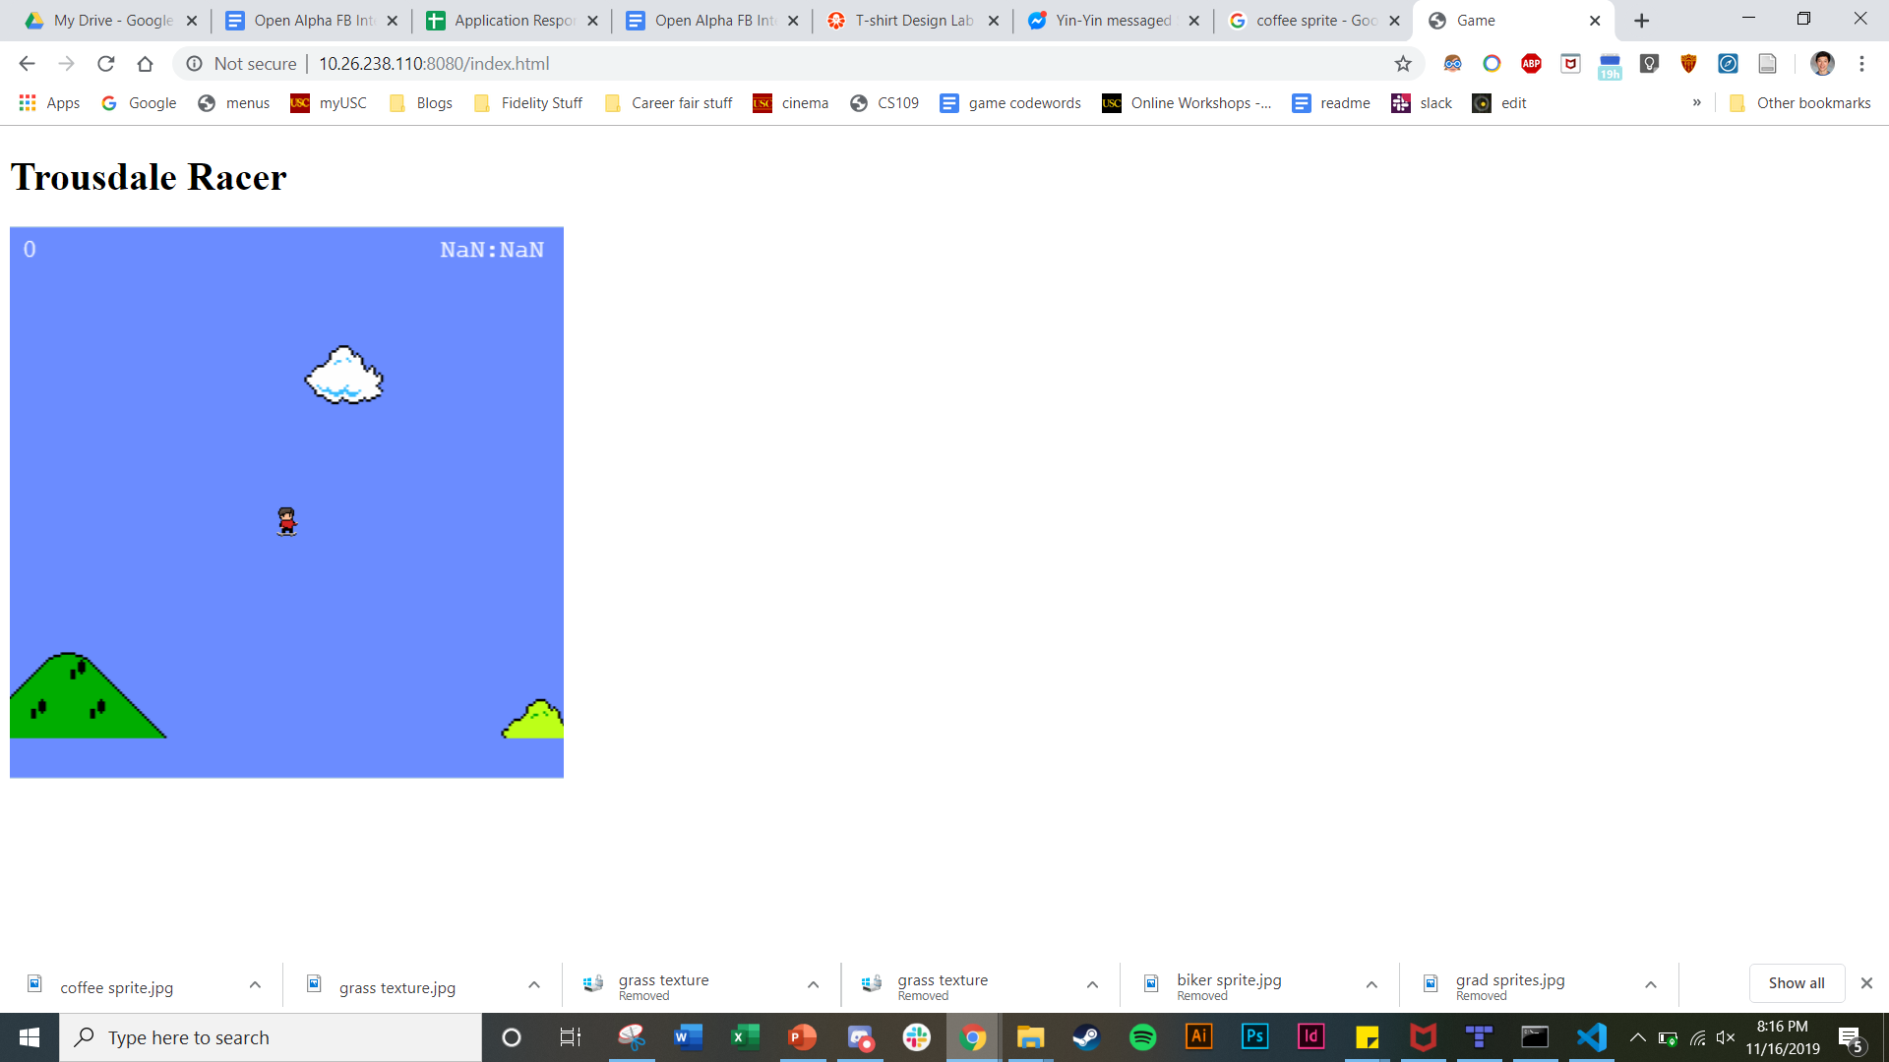
Now Featuring:
- Big Tile Map Background
- Camera Scrolling
Big Background Tile Map
Camera Scrolling

Slide 5
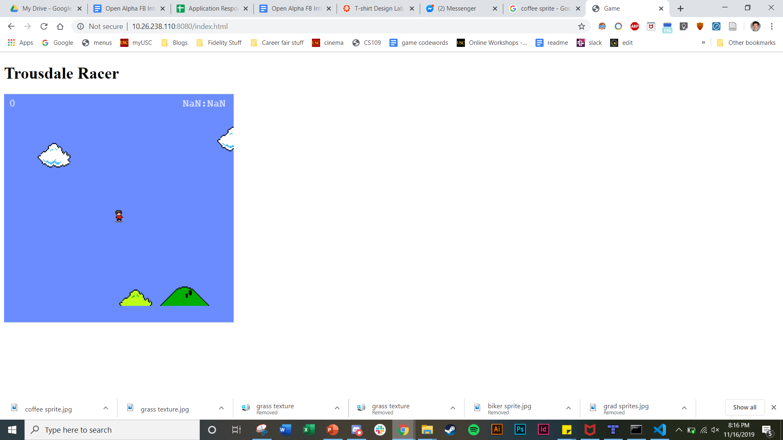
Big Background Tile Map
Camera Scrolling

Slide 6
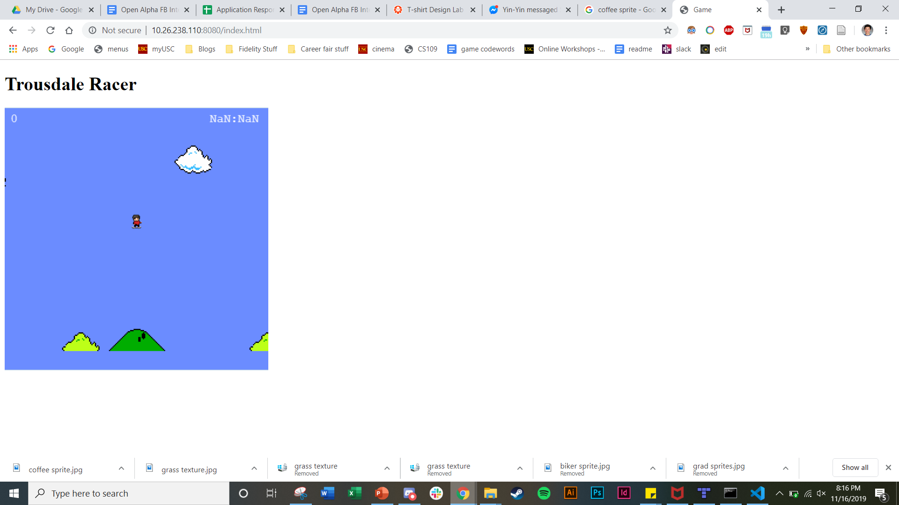
Big Background Tile Map
Camera Scrolling

Slide 7

Big Background Tile Map
Camera Scrolling

Slide 8
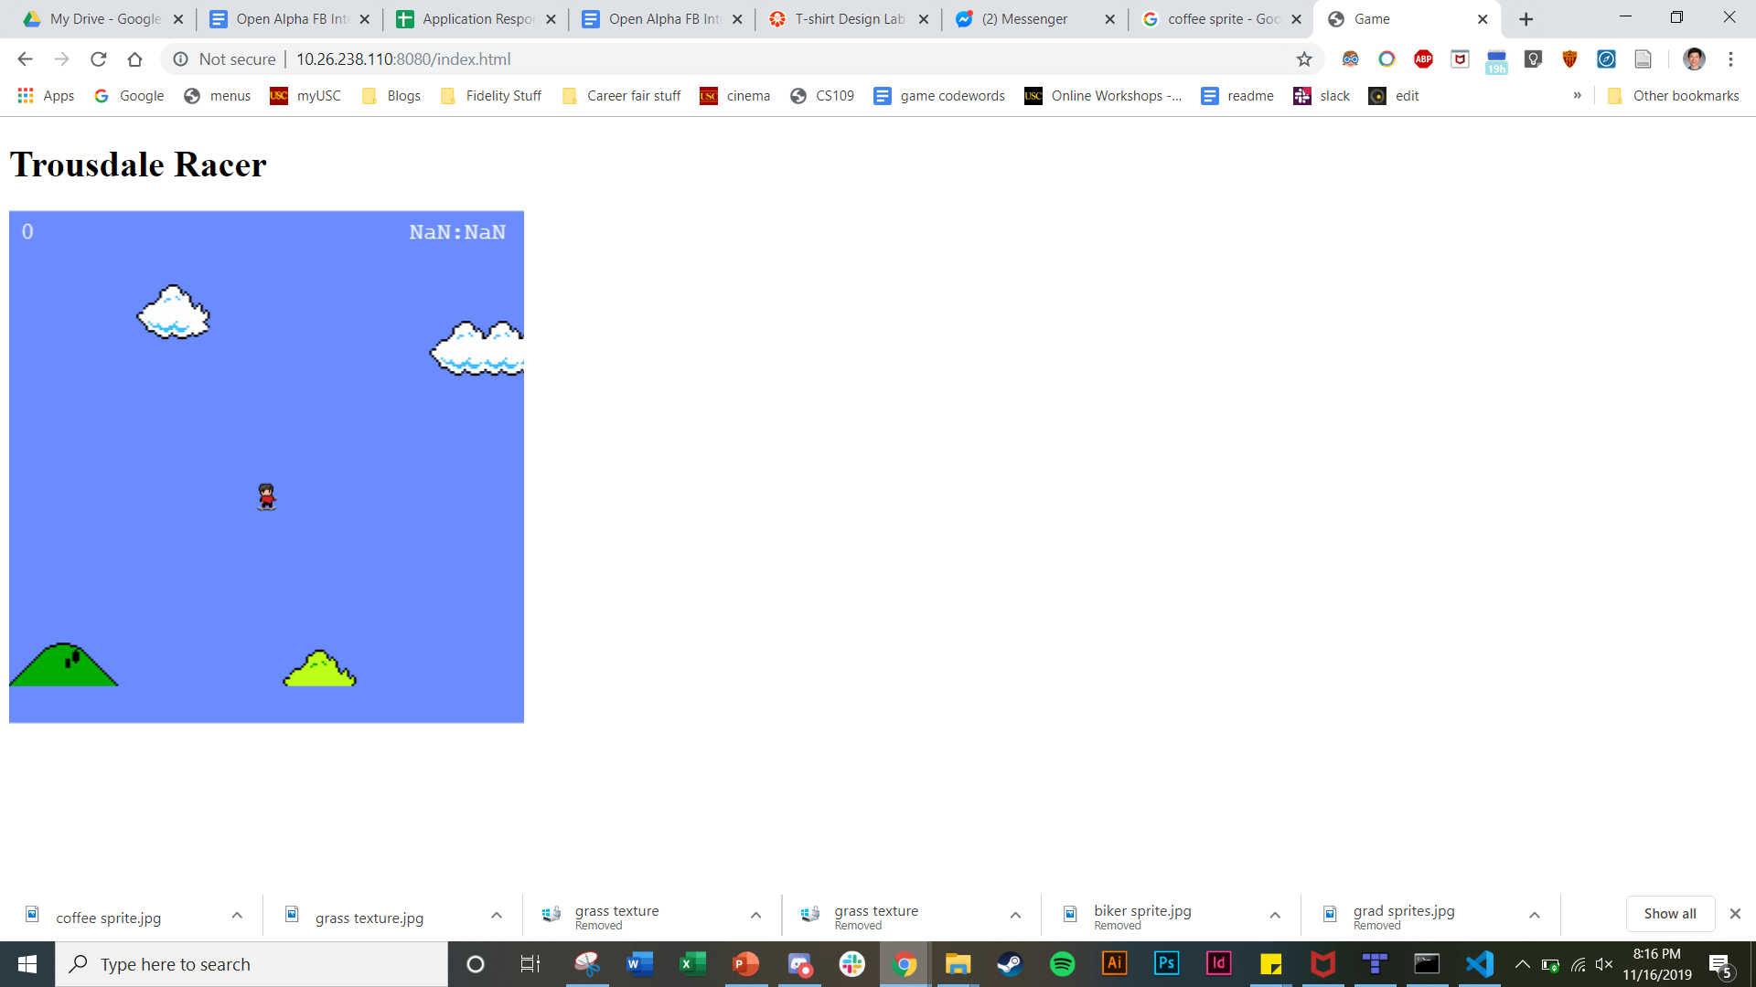
Big Background Tile Map
Camera Scrolling

Slide 9
Gameplay Mockup

Slide 10


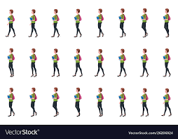
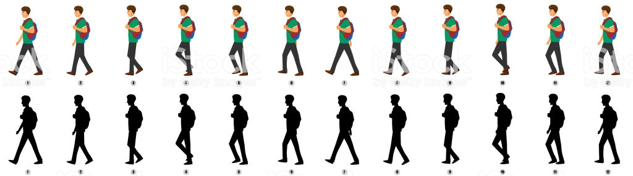




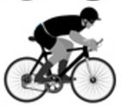

Slide 17
MPH

Slide 18
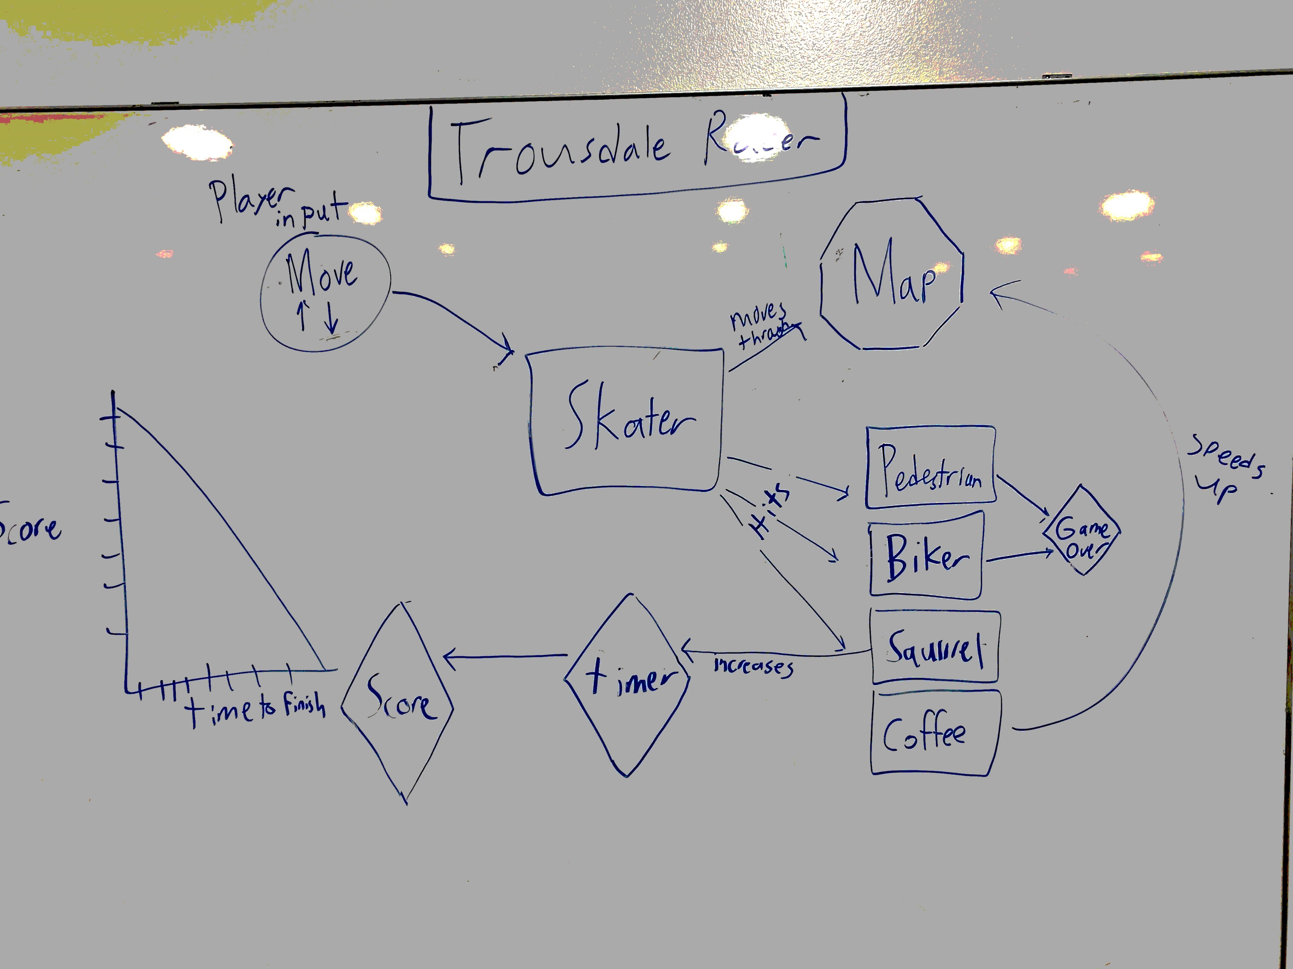
Game System Model
(using GSML- game system modeling language)

